Slide 2
Program Overview
Aligning to ‘One’ Team Model
Objectives
BUSINESS STAKEHOLDERS
Review data pivots
Review requirements against the cube
Data quality checks
Roadmap Alignment Scope, Features, Upgrades
KPIBilling Cube, ARC, RVR
On going data check points with
KPIBilling Cube Team,
RvR Team,
ARC Team
Connect with ES Incentives & Billing team in Chennai
Impact Analysis Dependencies, Quality, Stability, Schedule
UCM-B Team
BUSINESS
ANALYSTS
AZURE INFRA TEAMS
ENGG TEAMS
DATA TEAMS
ANALYSTS
Reviews on Cube data accuracy
Inputs on new measures to enable faster and easier usage
Risk Mitigation
Check Points, Reviews, SLAs
Knowledge Sharing
Features, Business Scenarios, Technology
AZURE INFRA TEAM
Track developments of ADF, ADLS and ADW
Continuous loop on feedback and stack evolution based on new features
UCM-A, Opportunities
Ingest Data from UCM-A
Onboard the Opportunities DW
Onboard Engineering DW
2

Slide 3
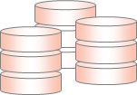


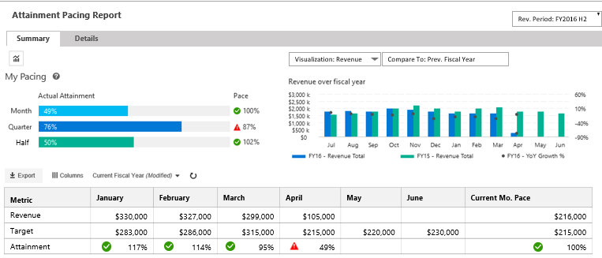
Architecture
Architecture Overview of UCM-B
SOURCES/
PRODUCERS
COLLECTION / STAGING
MERGE/CLEANSING
/ENRICHMENT
TRANSFORMATION
BUSINESS RULES
CACHED VIEWS
PIVOTS
PRESENTATION/
ACTIONS
Azure Data Factory
[ Data Ingestion, Layers Orchestration and Data Auditing]
Staging Area Subscriber
[Accounts, Customer, Exchange rates, etc.]
ETL
Adhoc Engines
Azure Data Lake
ADW
MDX CUBE
KPIs, Metrics Hierarchy
ADLS STAGING
WARM
Business
Users
Confirmed Dimensions
Date, Product, etc.
Optimized for 2 year
SQL Sources
PAAS: UCM
On-Premise : MDB
SQL Server Gateway
USQL
ADLS STAGING
WARM
Dimensions
Customer, Account, ..
Delta Merges
Business Reporting Views
UCM-B Business Reporting Web site
Analysis Services
RvR Cube
PowerShell Upload
Facts
Revenue, Attainments,
Relational DW
Account Teams
ADLS as TSV
[Archived daily]
Maps
Account-CU, Timeline
Cached Data
WWIC Flat Files
Structured Files
[KPIBillingCube]
WWIC Views
COLD
USQL
HYBRID PROCESSING
WWIC Teams
HYBRID STORAGE [BLOB/DB]
NORMALIZE
METRICS ENGINE
REPORTING and UIX

Slide 4

Data Flows & Pipelines
Data sources & Pipelines in UCM-B
SOURCES/
PRODUCERS
STAGING
ADLS
CLEANSING
/ENRICHMENT
TRANSFORMATION
ADLA / USQL
RDBMS
ADW
CACHED
VIEWS
PIVOTS
Cube
PRESENTATION/
ACTIONS
Accounts
Customer
Exchange
Staging Area Subscriber
FULL FILE
MERGING
CATALOG
TABLE(S)
1
ATTAINMENTS
--------------------
CLIENT UNIT
SEGMENT
NEW BUSINESS
CHANNEL PARTNER
MDX Cube
Timeline
MDB
FULL FILE
MERGING
CATALOG
TABLE(S)
2
Assignments
Quotas
Teams
UCM
FULL FILE
MERGING
CATALOG
TABLE(S)
3
6
Gross, Net, Billed
RvR
WWIC VIEWS
WWIC Hand off DB
[FUTURE]
WWIC Flat Files
FULL DATA
DEGENERATION
CATALOG
TABLE(S)
4
8
Revenue
REVENUERECSUMMARY
INCR FILE
DEGENERATION
CATALOG
TABLE(S)
UCM BUSINESS REPORTING
5
BUSINESS REPORTING
7

Slide 5
Data Flows & Pipelines
Program Overview
1
UCM-B Staging Area Subscriber Pipeline
SOURCES/
PRODUCERS
STAGING
ADLS
CLEANSING
/ENRICHMENT
TRANSFORMATION
ADLA / USQL
RDBMS
ADW
CACHED
VIEWS
PIVOTS
Cube
PRESENTATION/
ACTIONS
Accounts
Customer
Exchange
Staging Area Subscriber
ATTAINMENTS
--------------------
CLIENT UNIT
SEGMENT
NEW BUSINESS
CHANNEL PARTNER
FULL FILE
MERGING
CATALOG
TABLE(S)
MDX Cube
FULL
Initial Storage Size
Data Period
# Rows
Time
~2 GB
All Accounts, Customer, Exchange, Data..
15 Million Rows
3 Days
~1 GB
Last 1 year
15 Million
1 Day [POLYBASE]
.5 GB
All Masters
15 Million
15 minutes
INCREMENTAL
Initial Storage Size
Data Period
# Rows
Time
~2 GB
All Accounts, Customer, Exchange, Data..
15 Million Rows
45-60 minutes
~ 150 KB
6 hours
2000 +
20 minutes
~100 KB
1 Day incremental
1000+
4-5 minutes
5

Slide 6
Program Overview
Data Flows & Pipelines
2
UCM-B MDB Pipeline
SOURCES/
PRODUCERS
STAGING
ADLS
CLEANSING
/ENRICHMENT
TRANSFORMATION
ADLA / USQL
RDBMS
ADW
CACHED
VIEWS
PIVOTS
Cube
PRESENTATION/
ACTIONS
ATTAINMENTS
--------------------
CLIENT UNIT
SEGMENT
NEW BUSINESS
CHANNEL PARTNER
MDX Cube
Timeline
MDB
FULL FILE
MERGING
CATALOG
TABLE(S)
FULL
Initial Storage Size
Data Period
# Rows
Time
2.5 GB
Account Time for last 16 months
11 Million Rows
1 hour
1 GB
16 months
11 Million
1 hour
0.5 GB
16 months
11 Million
15 minutes
INCREMENTAL
Initial Storage Size
Data Period
# Rows
Time
2.5 GB
Account Time for last 16 months
11 Million Rows
1 hour
~10 MB
1 day
1000+
15 minutes
[INCREMENTAL MERGE]
~100 KB
1 Day incremental
1000+
5-6 minutes
6

Slide 7
Program Overview
Data Flows & Pipelines
3
UCM-B Quota and BoB Pipeline
SOURCES/
PRODUCERS
STAGING
ADLS
CLEANSING
/ENRICHMENT
TRANSFORMATION
ADLA / USQL
RDBMS
ADW
CACHED
VIEWS
PIVOTS
Cube
PRESENTATION/
ACTIONS
Assignments
Quotas
Teams
UCM
ATTAINMENTS
--------------------
CLIENT UNIT
SEGMENT
NEW BUSINESS
CHANNEL PARTNER
MDX Cube
FULL FILE
MERGING
CATALOG
TABLE(S)
FULL
Initial Storage Size
Data Period
# Rows
Time
5 GB
5 months [from July 2016]
>10 million rows
1 hour
2.5 GB
5 months
10 Million
1 hour
1 GB
5 months
10 Million
20 minutes
INCREMENTAL
Initial Storage Size
Data Period
# Rows
Time
5 GB
5 months [from July 2016]
>10 million rows
20 minutes
Few MB
1 day
~1000
10 minutes
Few MB
1 day
~1000
10 minutes
7

Slide 8
Data Flows & Pipelines
Program Overview
4
UCM-B RvR Pipeline
SOURCES/
PRODUCERS
STAGING
ADLS
CLEANSING
/ENRICHMENT
TRANSFORMATION
ADLA / USQL
RDBMS
ADW
CACHED
VIEWS
PIVOTS
Cube
PRESENTATION/
ACTIONS
Gross, Net, Billed
RvR
ATTAINMENTS
--------------------
CLIENT UNIT
SEGMENT
NEW BUSINESS
CHANNEL PARTNER
MDX Cube
FULL DATA
DEGENERATION
CATALOG
TABLE(S)
FULL
Initial Storage Size
Data Period
# Rows
Time
Few MB
Data records from 2009
Few thousand
1 Day
100 MB
7 years
~ 2000 records
15 minutes
100 MB
7 Years
~2000 records
10 minutes
INCREMENTAL
Initial Storage Size
Data Period
# Rows
Time
Few MB
Data records from 2009
Few thousand
Every Month
100 MB
7 years
~ 2000 records
15 minutes
100 MB
7 Years
~2000 records
10 minutes
8

Slide 9
Data Flows & Pipelines
Program Overview
5
UCM-B RevenueRecSummary Pipeline
SOURCES/
PRODUCERS
STAGING
ADLS
CLEANSING
/ENRICHMENT
TRANSFORMATION
ADLA / USQL
RDBMS
ADW
CACHED
VIEWS
PIVOTS
Cube
PRESENTATION/
ACTIONS
Revenue
REVENUERECSUMMARY
INCR FILE
DEGENERATION
CATALOG
TABLE(S)
ATTAINMENTS
--------------------
CLIENT UNIT
SEGMENT
NEW BUSINESS
CHANNEL PARTNER
MDX Cube
FULL
Initial Storage Size
Data Period
# Rows
Time
800 GB
16 Months
3.6 Billion Rows
3 Days
180 GB
16 Months
3.6 Billion Rows
3 Days [POLYBASE]
30 GB
16 Months
1.8 Billion Rows
3 Hours
INCREMENTAL
Initial Storage Size
Data Period
# Rows
Time
6 GB
1 Day
3-5 Million Rows
90 minutes
.5 GB
1 Day
3-5 Million Rows
30 minutes
100 MB
1 Day
1-2 Million Rows
15-20 minutes
9

Slide 10
Data Flows & Pipelines
Program Overview
6
UCM-B Attainments Pipeline
SOURCES/
PRODUCERS
STAGING
ADLS
CLEANSING
/ENRICHMENT
TRANSFORMATION
ADLA / USQL
RDBMS
ADW
CACHED
VIEWS
PIVOTS
Cube
PRESENTATION/
ACTIONS
Revenue
REVENUERECSUMMARY
INCR FILE
DEGENERATION
CATALOG
TABLE(S)
ATTAINMENTS
--------------------
CLIENT UNIT
SEGMENT
NEW BUSINESS
CHANNEL PARTNER
MDX Cube
FULL RESTATEMENT
Initial Storage Size
Data Period
# Rows
Time
400 GB
5 Months [ From July 2016]
~ 3 Billion Attainment Records
7-12 hours for full restatement
INCREMENTAL
Initial Storage Size
Data Period
# Rows
Time
2 + GB
1 Day
3-5 Million Rows
90 minutes
10

Slide 11
Data Flows & Pipelines
Program Overview
7
UCM-B Business Reporting Pipeline
SOURCES/
PRODUCERS
STAGING
ADLS
CLEANSING
/ENRICHMENT
TRANSFORMATION
ADLA / USQL
RDBMS
ADW
CACHED
VIEWS
PIVOTS
Cube
PRESENTATION/
ACTIONS
ATTAINMENTS
--------------------
CLIENT UNIT
SEGMENT
NEW BUSINESS
CHANNEL PARTNER
UCM BUSINESS REPORTING
BUSINESS REPORTING
VIEWS
UCM-B Business Reporting Web site
FULL / INCREMENTAL
Initial Storage Size
Data Period
# Rows
Time
100 MB
Incremental Merge [16 months]
~ 1 Million Rows [monthly grain]
60 minutes
11

Slide 12
Data Flows & Pipelines
Program Overview
8
UCM-B WWIC Feeds Pipeline
SOURCES/
PRODUCERS
STAGING
ADLS
CLEANSING
/ENRICHMENT
TRANSFORMATION
ADLA / USQL
RDBMS
ADW
CACHED
VIEWS
PIVOTS
Cube
PRESENTATION/
ACTIONS
ATTAINMENTS
--------------------
CLIENT UNIT
SEGMENT
NEW BUSINESS
CHANNEL PARTNER
WWIC Hand-Off Database
WWIC
VIEWS
WWIC Feed files in SharePoint
BATCH
Initial Storage Size
Data Period
# Rows
Time
Feeds for one Semester
Weekly for Domain and Monthly for Revenue
~ 1 Million Rows
60 minutes
12

Slide 13
Program Overview
Data Flows & Pipelines
UCM-B Data Pipelines view - Overall
SOURCES/
PRODUCERS
COLLECTION / STAGING
[Azure Data Lake Storage]
CLEANSING
/ENRICHMENT
TRANSFORMATION/
BUSINESS RULES/
CACHED VIEWS
PIVOTS
PRESENTATION/
ACTIONS
Accounts
Staging Area Subscriber
Azure Data Factory [Data Ingestion, Layers Orchestration and Data Auditing]
Timeline
MDB
ADHOC & Reporting Engines
Assignments
Quotas
Teams
UCM
AZURE SSAS SERVICE
USQL
SQL
AZURE DATA WAREHOUSE
AZURE DATA LAKE
AZURE IAAS (SQL 2016)
ADLS
Azure Storage
Data Cleansing,
Data Processing (USQL)
Data Archival
Data Catalog
Relational DW
Star Schema
Pre-cached Views
Business Reporting Views
MDXCube
Measures
KPIs
UCM-B Business Reporting Web site
RvR
REVENUERECSUMMARY
Full Total Storage /
Full Data Period /
# Rows
1.2 TB / 16 Months
1.2 TB / 16 Months
1.2 TB / 16 Months /
8 Billion
80 GB/ 16 Months /
2.5 billion
Incremental Storage /
Incremental Period /
Processing Time
10 GB/ 1 day / 2 Hours
5 GB/ 1 day / 1 Hour
2.5 GB/ 1 day / 1 Hour
1 GB/ 1 day / 2 hr.
RESTATEMENT
400 GB /6 months/
7-12 Hours
40 GB/ 6 months / 4 hr.

Slide 14
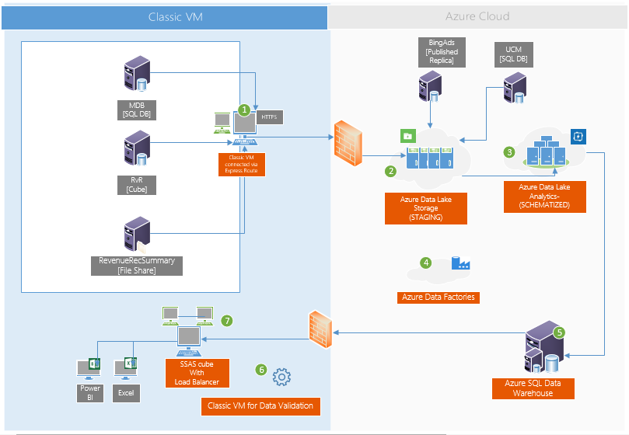
What is the Infra view of UCM-B on Azure ?
Infrastructure
Program Overview
Classic VM connected via Express Route to pull data from RvR, RevenueRecSummary, MDB and to host the Gateway connector [1 TB of space/112 GB RAM]
Azure Data Lake to stage data from all the sources
Azure Data Lake Analytics to make data catalog and process data
Azure Data Factories to move the data
Azure SQLDW-copy of schematized tables from catalog by ADF
Azure VM for triggering and running validation
Classic VM connected via Express Route to pull data from Azure SQL Data Warehouse and build a SSAS cube

Slide 15
Program Highlights
Reusable assets in UCM-B
USQL [ADL] Code blocks
Data Cleansing ,Enrichment and Versioning
SCDs (Slowly changing dimensions).
UCM-B is architected as a ‘Container’ data platform to host multiple areas of business including Sales, Marketing, Incentives, Opportunities, Engineering Audits of UCM system
All the layers are built as re-usable engines and can be easily customized for any program
Data Mastering
Data Mastering libraries for Type 2, etc.
Data enrichment with Cross-referenced data
Data Ingestion
Data Ingestion from SQL Databases, Cosmos Feeds, Flat Files and Services
Source Data Checks and Pre-cleansing
GIT Enabled
PowerShell, Firefly and Azure Resource Manager
Deployment
Data Validation
25+ rules for data validation and coverage
Complete engine designed in PowerShell for reuse
Hybrid Data Warehouses with ADL and ADW
Separation of Data Concerns and Replicas with ‘Staging’, ‘EDW’ and ‘Views’
Azure Data Warehouse

Slide 16
Journey So Far
What we achieved so far…
5 Source Systems On boarded [Bing Ads, RVR, RevRecSummary, MDB, UCM]
55 P0/P1 metrics Delivered
17 Excel Pivots covering 18 Measures
300+ test cases for e-2-e Validation with 150+ automated
59 critical PoCs performed on Azure, ADF, ADL,COSMOS,ADW, Cube
24x7 Cube availability to analysts with load balancer and automated backups
50% continuous delivery capabilities with well-defined automated validation and release/deployment process adopting GIT for non-standard projects like ADF, ADLS and ADW.
Engineering Data Warehouse - External Service Call, MT Request, UI Telemetry and User Action – are On boarded.
16

Slide 17

Future Plan
What is the roadmap for UCM-B
Business Roadmap
Technology roadmap
Deliver Spend Reporting Metrics including Clicks, Impressions, etc.
Deliver the P1 and P2 metrics including merging data with Campaigns, etc.
One stop data platform for 3 years of data
Optimization of Data warehouse layers to enable faster analysis and reporting across data volume of 3 years
Onboarding and Integrating EDW
Deliver full scale CI/CD
Integrate validation engine during production deployment and automate data coverage tests
Implement data lineage framework
Scenario automation in addition to standard data quality checks
Onboard Engineering DW
Develop full scale capabilities for EDW on the same data lake
Data Platform as Lake
Ease and self-service onboarding other data objects including Opportunities etc.
100% Cloud enabled
Migrate the existing SSAS IAAS Cube to Azure Analysis Services
17

Slide 18
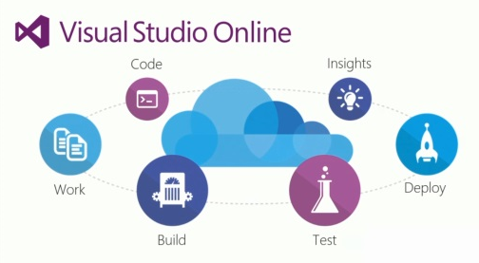




Build-2-Prod
Component Based Architecture
What is the ‘Build-2-Deploy’ process in UCM
We achieved 50-60% Continuous delivery capabilities for large BI applications..
Tailored
Adopted
Designed and tailored a well-defined automated validation and release/deployment process for Azure Data Warehouses.
Integrated
We adopted GIT for non-standard and unsupported projects like Azure Data Factories, Azure Data Lakes and ADW
Explored and Integrated additional tools like FireFly, CloudBuild, Azure Automation etc.
Developed an automated validation framework to QA the data
Create Custom Frame work through PowerShell to achieve CI/CD
Level 1
Level 3
Level 4
Level 5
Level 6
VSO, Code Flow
CloudBuild, Email
VSO Git
Azure Deployment
Coding Standards
Iterations
Signoff by Experts
CodeFlow
Buddy Build before check-in
Notifications
Git Check In
Branches
Commits
Merges
Green Builds
Azure Automation
Validate
Email Reports
Power BI Live Reports
Monitor
Alerts
Load Balancers
Level 2
Git Builds
SQL Azure, ADL, ADW
System Stats
Downtime healing
>670
Code Flows
<10 mins
build time
2300+
BI Code Artifacts
30+
PPE & Prod Deployment
>199 - Test Cases
>428 - Test Runs
30+
Auto heal rules
3100+
Code Comments
500+
Code merges
2 hours
Avg. Time to Deploy
~8 hrs.
For 5 Billion records
>120
Mail Alerts

Slide 19
What are the challenges in data quality on Azure Big Data systems..
Data Quality
Vision
Data volume and velocity is at a high pace and non-relational too..
Manual validation and QC is beyond the scope ..
Lack of traditional policy checks like PKs, FKs, etc.
Putting together ACID rules is hard
Data counts needs to be continuously checked..
Need to know the freshness of billions of data..
Need to ensure data coverage of transition of millions records across storage layers
Data moves between relational and non-relational stores and ensuring consistency
1
Develop a generic data quality engine that can run on Azure and capable of verifying data against multiple data sources including Azure DBs, Azure Data Lake, Warehouses and MDX Cubes
2
3
4
Distributed business rules..
Data is processed at multiple stages and faults can occur anywhere..
Goals
Support multiple connectors
Fully automated testing
Dynamic scalability
Centralized Governance
Team & Reports friendly
5
Lack of Visual Studio validation tools
No ready available tools like Performance tester etc.
6

Slide 20
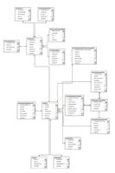
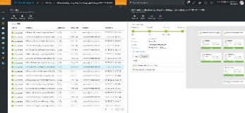
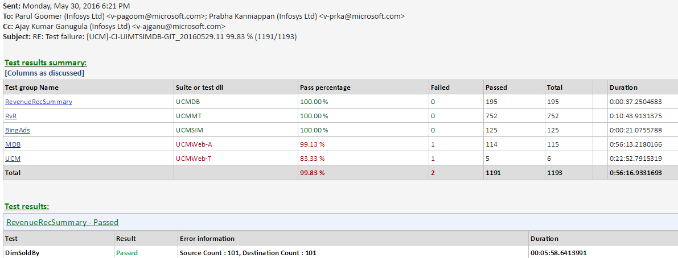
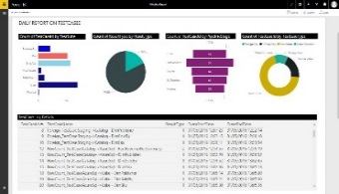
Data flow diagram of the Data Quality engine
Data Quality
Data Quality
Authoring
Execution
Data Quality Engine enabled to validate 18 rules likes value checks, primary key checks, row count checks etc.
Comprehensive work flow for authoring, execution and monitoring for Azure Data warehouse and Azure Data Lake
ATC (Automated Test Controller) with daily mails to all the stake holders
Live Power BI dashboards for analyzing the quality of the system
Test Case Authoring Engine
Test Case Scheduling
Test Case Flags
PowerShell Engine
Execute on
ADL
ADW
DB
Files
Alerting
Monitoring
Emails with Logs
Action on Bugs
Missing test cases
Live Visualization
View Logs
View Exceptions

Slide 21
Data Quality
What are the rules validated in UCM-B
SOURCES/
PRODUCERS
STAGING
ADLS
CLEANSING
/ENRICHMENT
TRANSFORMATION
ADLA / USQL
RDBMS
ADW
CACHED
VIEWS
PIVOTS
Cube
PRESENTATION/
ACTIONS
Data availability
Count Check
PrimaryKey Check
BoB & Quota Checks
Data Length Check
Data archiving
Foreign Key Check
Attainment Checks
Client Unit
Segment
New Business
Channel Partner
Missing Quota
Data Type Check
Dev/Prod Checks
Other Cube Check:
ARC
RvR
KPI Billing
Duplicate Row Check
All the rules above are automated using a custom PowerShell engine
21

Slide 22
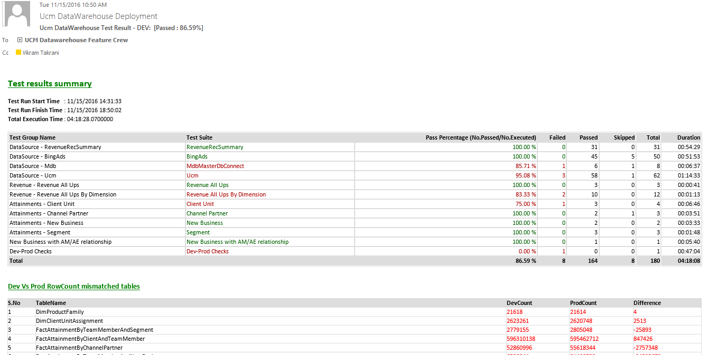
Daily Validation status in email
Program Highlights

Slide 23
Data Models – Revenue & Billing
Design & Engineering
Optimized Data Model based on down stream needs
Fully normalized schema for dimension-fact modeling
De-normalized schema opted for Attainments [Derived facts] to increase performance
View the data models here..

Slide 24

.
Design & Engineering
What are the Key Pain Points on Azure Infra
Visual Studio
Lack of Visual Studio support for ADW and Business Intelligence Scenario testing
Lack of Visual Studio CI/CD, Data Coverage and Performance testing for Data
Azure Data Lake
Data Integrity constraint in Azure Data Lake
Lack of Polybase and PowerBI direct connection to ADLS catalog
Security
Data Masking, Encryption and Transparent Data Security not available in ADL yet
Centrally managed with AAD (Azure Active Directory) Service Accounts, but not at the roles level
Azure Data Factories
Orchestration across pipelines still not available and need for manual scheduling across pipelines
Pipelines couldn’t take parameters from external command/PowerShell or other pipelines
Azure Data warehouse
ADW is designed to perform heavy queries, but only 32 queries can run at a time.
When ADW experience heavy load, it automatically shutdown all connections.

Slide 25
.
Design & Engineering
What is the help required from Azure team
Visual Studio
Quality tools for data coverage and scenario testing [similar to code coverage in Visual studio]
CI/CD capability for ADW [similar to SSDT for Azure SQL]
Azure Data Lake
API to perform caching and performance improvements
Drivers for direct connectivity to Power BI and other down stream applications
Security
Data encryption and security on ADLS
Ability to enable roles and access on the Azure Analysis Preview Services
Azure Data Factories
Manage Centralized Orchestration across various pipelines
Able to call PowerShell scripts as part of pipelines
Azure Data warehouse
Ability to automatically detect the best performance for a table [currently the developer need to configure for performance as round robin etc.]
Ability to audit information [for ex. Temporal tables similar to SQL Server]

Slide 26
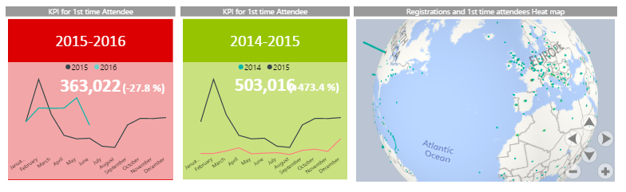

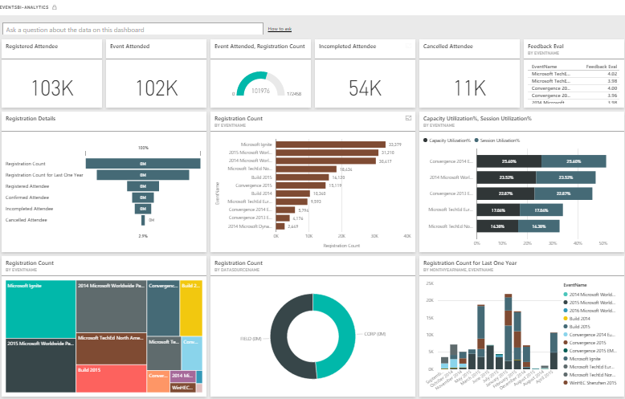
Reporting Case Study
Case Study #1 - Events BI (Big Data - COSMOS + Power BI)
There is no capability to process Events(TechEd events, online trainings, premiums sessions) tools data (attendee information, pre and post event) to enable business to derive meaningful and connected insights.
Enabled end users in self service reporting using R Analytics and Power BI
Strong, reliable and scalable Unified Data Platform for Events BI reporting needs on Power BI
< 2hrs
Data Refresh
80K
Organizations
700K
Attendees
50K
Events
1.1M
Registrations

Slide 27
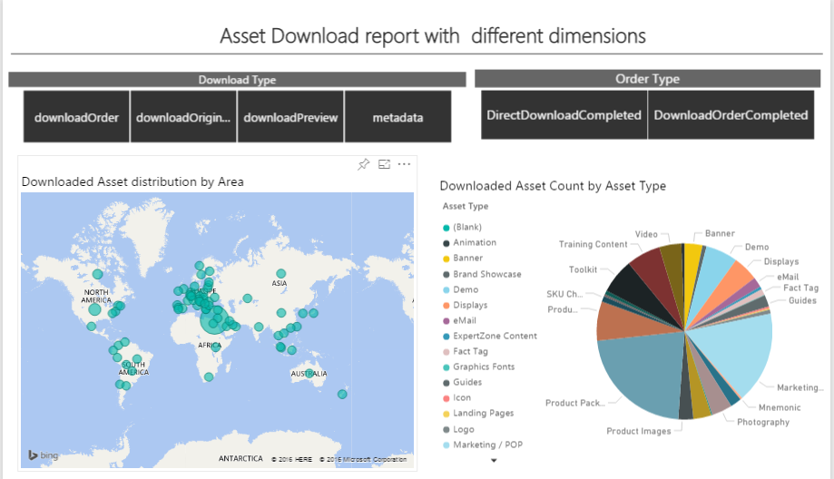
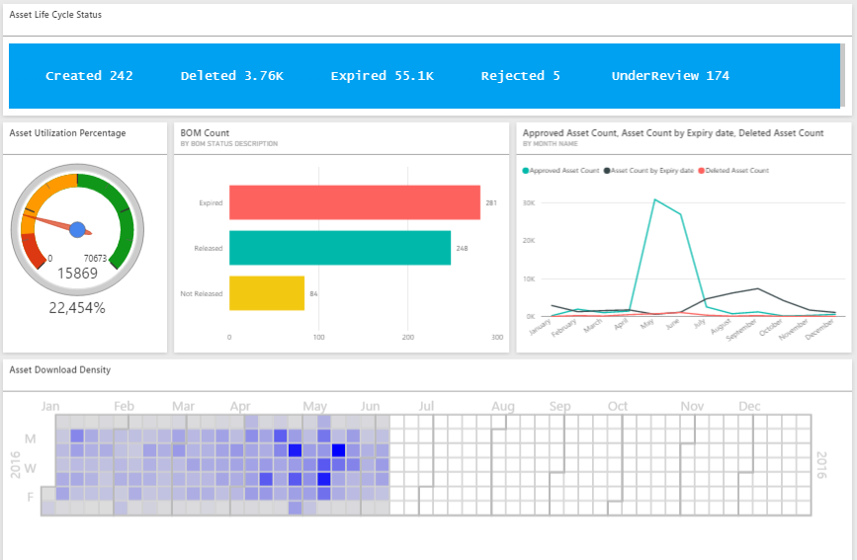
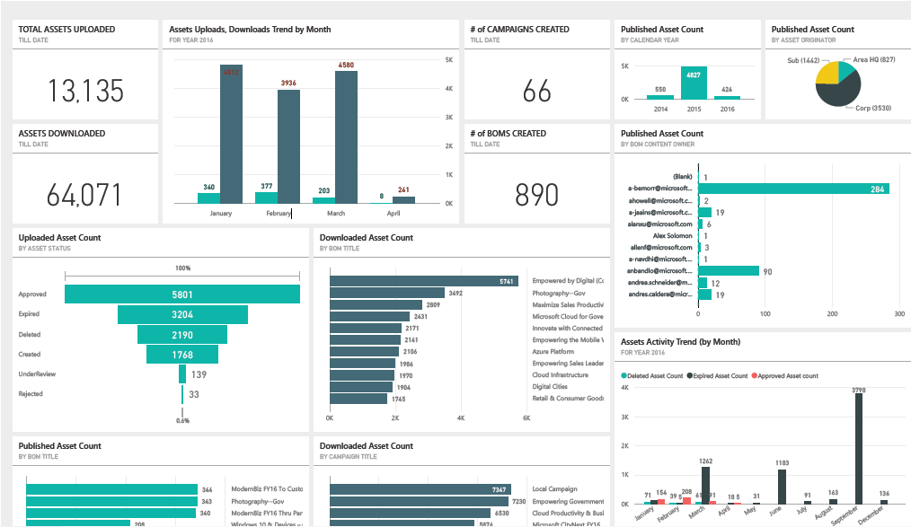
Reporting Case Study
Case Study #2: Cloud DAM Reporting Platform
Existing HTML5 dashboards were static and not able to scale up to the changes in Business needs and requires lot of development effort to implement the changes.
Enabled end users in self service reporting using Power BI and Excel
Strong, reliable and scalable Unified Data Platform for Cloud DAM reporting needs on Power BI and Excel
ETL of 25M records in Audit Trail JSON source in ~6 hours
7 Live Tenants and 20 in Pipeline
50+ Power BI Reports
27

Slide 28

Appendix
[The slides below are for reference purposes]

Slide 29
UCM-B Simplified Data Flow
SOURCES/
PRODUCERS
COLLECTION / STAGING
[Azure Data Lake Storage]
CLEANSING
/ENRICHMENT
TRANSFORMATION/
BUSINESS RULES/
CACHED VIEWS
PIVOTS
PRESENTATION/
ACTIONS
MDB
ADCRM
ON PREMISE
Azure Data Factory [Data Ingestion, Layers Orchestration and Data Auditing]
VM
USQL
SQL
AZURE DATA WAREHOUSE
SQL Server 2016 on VM
ADLS
Azure Storage
AZURE DATA LAKE
ADHOC & Reporting Engines
Data Cleansing
Data Enrichment
Type 2 Dimensions
Data Archival
Attainments
Business Reporting Views
WWIC Views
Opportunities
..
Billing Cube
Bing Ads
Ucm
Exchanges
AZURE SQL
DB
Business Reporting Web App
Azure SQL
KPI Billing
FLAT FILES
Business Reporting
DB
Monetization
Clicks
Impressions
Budget Pause
Accounts
COSMOS
WWIC Feeds
[EXCEL]
INCR/FULL DATA

Slide 30
Archival
Archival View in UCM-B per instance [Bottom grey layer is the archival size]
SOURCES/
PRODUCERS
COLLECTION / STAGING
MERGE/CLEANSING
/ENRICHMENT
TRANSFORMATION
BUSINESS RULES
CACHED VIEWS
PIVOTS
PRESENTATION/
ACTIONS
Azure Data Factory
[ Data Ingestion, Layers Orchestration and Data Auditing]
Staging Area Subscriber
[Accounts, Customer, Exchange rates, etc.]
ETL
Adhoc Engines
Azure Data Lake
ADW
MDX CUBE
KPIs, Metrics Hierarchy
ADLS STAGING
WARM
Business
Users
Confirmed Dimensions
Date, Product, etc.
Optimized for 2 year
SQL Sources
PAAS: UCM
On-Premise : MDB
SQL Server Gateway
USQL
ADLS STAGING
WARM
Dimensions
Customer, Account, ..
Delta Merges
Business Reporting Views
UCM-B Business Reporting Web site
Analysis Services
RvR Cube
PowerShell Upload
Facts
Revenue, Attainments,
Relational DW
Account Teams
ADLS as TSV
[Archived daily]
Maps
Account-CU, Timeline
Cached Data
WWIC Flat Files
Structured Files
[KPIBillingCube]
WWIC Views
COLD
USQL
HYBRID PROCESSING
WWIC Teams
HYBRID STORAGE [BLOB/DB]
NORMALIZE
METRICS ENGINE
REPORTING and UIX
~500 GB
Revenue files last 6 months
~500 GB
ADLS stg files last 6 months
~200 GB
ADLS processed files last 6 months
~80 GB
Per day
~100 MB
Per batch

Slide 31
NFR view in UCM-B
SOURCES/
PRODUCERS
COLLECTION / STAGING
MERGE/CLEANSING
/ENRICHMENT
TRANSFORMATION
BUSINESS RULES
CACHED VIEWS
PIVOTS
PRESENTATION/
ACTIONS
Azure Data Factory
[ Data Ingestion, Layers Orchestration and Data Auditing]
Staging Area Subscriber
[Accounts, Customer, Exchange rates, etc.]
Fast ETL
Adhoc Engines
Azure Data Lake
ADW
MDX CUBE
KPIs, Metrics Hierarchy
ADLS STAGING
HOT
Business
Users
Confirmed Dimensions
Date, Product, etc.
Optimized for 2 year
SQL Sources
PAAS/On-Prem
[MDB, UCM, etc.]
SQL Server Gateway
USQL
ADLS STAGING
Dimensions
Customer, Account, ..
Delta Merges
WARM/COLD
Analysis Services
RvR Cube
PowerShell Upload
Facts
Revenue, Attainments,
Relational DW
Business Reporting Views
UCM-B Business Reporting Web site
ADLS as TSV
[Archived daily]
Maps
Account-CU, Timeline
Cached Data
Account Teams
Structured Files
[KPIBillingCube]
WWIC Views
COLD
USQL
HYBRID PROCESSING
HYBRID STORAGE [BLOB/DB]
NORMALIZE
METRICS ENGINE
REPORTING and UIX
AZURE CAPABILITIES
ENCRYPTION
SECURITY
DATA QUALITY
TELEMETRY
LOGGING
ERROR HANDLING
WORK FLOWS
GOVERNANCE
META-DATA
LINEAGE
AUDITS
REPORTS
ALERTS
ROLES
RULES

Slide 32
Data Flows & Pipelines
Program Overview
EDW Pipeline is also functional and needs to be integrated
SOURCES/
PRODUCERS
STAGING
ADLS
CLEANSING
/ENRICHMENT
TRANSFORMATION
ADLA / USQL
RDBMS
ADW
PIVOTS
Cube
PRESENTATION/
ACTIONS
External Service Call, MT Request, UI Telemetry, User Action
MDX Cube
FULL DATA
DEGENERATION
CATALOG
TABLE(S)
FULL
Initial Storage Size
Data Period
# Rows
Time
~ 300 GB
10 Months
~500 Million Records
3 Days
~ 250GB
10 Months
~ 500 Million Records
1 Day [POLYBASE]
~ 2.2GB
10 Months
~ 500 Million records
1.5 Hour
INCREMENTAL
Initial Storage Size
Data Period
# Rows
Time
~ 2.5 GB
1 Day
1 – 2 Million Records
20 – 25 Mins
~ 2 GB
1 Day
1 – 2 Million Records
10 - 15 minutes
~ 20MB
1 Day
1 – 2 Million Records
10 minutes
32

Slide 33

What is the criteria in choosing a ‘high-performance’ data platform for UCM-B
Design & Engineering
 | Azure DW | Azure Data Lake | COSMOS
 | SQL Azure DWH – PAAS solution with elastic scale for performance/scalability Central DWH contains granular data | Azure Data Lake store/analytics aligning to Cortana Analytics Suite | COSMOS Data store for processing/storing data
Volume | Traditional central EDW is known to work for the projected volume but may not be optimal with data size of 1-2 TB | Physically partitioned data and hence can accommodate higher volumes. | Designed for high volume data warehouses.
Load Performance | Load performance can be matched with increased DTUs but comes with cost | Parallel processing with MPP results in better performance and performance can be boosted with increased DTUs | Parallel processing with Map-Reduce results in better performance.
Data Access | Access is easier. Query performance can be an issue. | Easier and data access through USQL other standard open source. | Data access restricted through Scope scripts
Scalability | 4-5 TB SQL Azure node has to be partitioned to multiple DBs | Can be scalable by adding more logical partitions for new data source/growth | Good Scalability
Strategic Alignment | Aligns with Cortana Analytics suite recommendation | Aligns with Cortana Analytics suite recommendation and strategy to migrated from COSMOS to ADL | With latest development with strategy to move to Azure Data Lake
Complexity | Simplest of the 3 approaches | Development and Complexity higher for configurable calculation engine | Development and Complexity higher for configurable calculation engine
Cost | Cost assuming a 4-5 TB size will be around $7000/TB | Medium considering Azure Data Lake instance and worker role process | Medium - High
Security Compliance | Storing PII/HBI data through encryption/ decryption modules | ADL support storing PII/HBI data at rest through OOB functionality | PI information in a common environment will not comply and has to do custom coding
Good Fit
Workaround Needed
Not Good Fit

Slide 34
Data Ingestion and Orchestration needs…
We had the challenge to find a right solution that can
Ingest millions of records per day
Orchestrate with On-Premise sources like SQL Servers and Cosmos, as well as cloud sources like SQL Azure databases
Have inbuilt capability to process data ‘as-is’ including files, databases, services etc.
We have chosen Azure Data Factories for ingestion and orchestration..

Slide 35

Data Ingestion–SQL Databases on-premise and Azure
Objectives
SOURCES/
PRODUCERS
COLLECTION
MERGING/CLEANSING/STAGING
TRANSFORMATION/
BUSINESS RULES
Acquire the Data from multiple SQL Source and Store it in ADL / Azure Data warehouse for stage, merged dataset and processed data as facts and dimensions
AZURE Data Factory
[Data Ingestion, Layers Orchestration and Data Auditing]
MDB
Azure Data Lake / DW – 2016 [Real Time]
Activities
UCM
Bridge Server
SQL instance and ADF gateway enabled
Staging
Cleansing
Merge
Enable the ADF Gateway Connector
Stage the data into Azure Data Lake directly
Merge the Stage data post cleansing into processed data using the defined business rule
Set the Archival rules accordingly
U-SQL
Processed Data
Slowly Evolving
Type 2 Dimensions
Visual Studio Integrated SCHEMA
Structured and Unstructured
Azure stretch enabled for Scalability
Others
SQL source both On Prem and SQL PaaS
NORMALIZE
HYBRID STORAGE AND PROCESSING

Slide 36
Data Ingestion– Flat files processing
SOURCES/
PRODUCERS
COLLECTION /
STAGING
MERGE/CLEANSING
/ENRICHMENT
TRANSFORMATION/
BUSINESS RULES/
Objectives
Pull and Store all RAW data from sources in time-hierarchy defined structure in staging
Cleanse data for data merging
Transform data into facts and dimensions or blobs for analytical needs
Azure Data Factory [ Data Ingestion, Layers Orchestration and Data Auditing]
Cleansed & Merged Data
Azure Data Lake / DW - 2016 [Near REAL TIME]
KPIBilling Data
File Copy
Slowly Evolving
Type 2 Dimensions,
Visual Studio Integrated SCHEMA
Structured and Unstructured
Azure Stretch enabled for scalability
RAW Data
Billing
RVR Data
RevenueRecSummary
Activities
RvR
Copy source data to the Azure Blob store using PowerShell.
Using Polybase/USQL transform the data including temporal-based joins, windowed aggregates, temporal filters, and other common operations such as joins, aggregates, projections, and filters
Do a basic check with SQL/USQL for data eligibility and reject if stream/data does not meet conditions.
Polybase/USQL
Azure BLOB Storage
RvR...txt
External Tables as Blobs
Weekly/Monthly/Quarterly Processing
Azure Stretch enabled for scalability
Others
Other File Stores
BLOB STORAGE
NORMALIZE
HYBRID STORAGE AND PROCESSING
Azure Data Factory will not scale beyond certain size, in those cases, we have to use PowerShell or SSIS

Slide 37

Data Ingestion – Structured data processing - Cosmos scenarios
SOURCES/
PRODUCERS
COLLECTION /
STAGING
MERGE/CLEANSING
/ENRICHMENT
TRANSFORMATION/
BUSINESS RULES/
Objectives
Pull and Store cleansed and conformed data from Cosmos structured stream to Azure Data Lake / DW
Process data from Azure BLOB to transform to Facts/Dimension
Billing
Azure Data Factory [ Data Ingestion, Layers Orchestration and Data Auditing]
.SS Files
Billing Data
Azure Data Lake / DW - 2016
Slowly Evolving
Type 2 Dimensions,
Visual Studio Integrated SCHEMA
Structured and Unstructured
Azure File Copy using ADF
Monetization
Monetization
Data
Activities
.SS Files
PowerShell for large files
Copy source data to the Azure Blob store using the Azure File copy. For cases where there is size limitation, proposal is to use PowerShell
Assumption is the data would be available in the cleansed format and no massaging or cleansing needed.
Data from Azure BLOB transformed through Polybase/USQL and SQL queries to transform to facts and dimension
Use ADF for orchestration
Apply security and encryption logic for PII data on Structured Streams to encrypt/hash the data
Polybase/USQL
Others
Other Streams
Azure Blob Store
Polybase/USQL
STORAGE AND PROCESSING

Slide 38
And also compared with Azure HD Insight
Cosmos
ADW
ADL
HD Insight
Storage
Capacity Constraints
Unlimited seamless scale
Unlimited seamless scale
Unlimited seamless scale
✓
✓
✓
✓
Compute
Capacity Constraints
Unlimited seamless scale
Unlimited scale post GA
Unlimited seamless scale
X
✓
✓
✓
Ecosystem/ Tooling
Minimal learning curve
Minimal learning curve
Minimal learning curve
3rd party tools learning curve
✓
✓
✓
~
Strategic Alignment
On migration path to ADL
PaaS service from Microsoft
PaaS service from Microsoft
Quasi-IaaS offering
~
✓
✓
~
Supportable
Internal, requires multiple layers.
Product Support
Product Support
Product Support
~
✓
✓
✓
Maturity
Lots of usage. Some instability
V1 Technology
Under Preview
Too many Tools
~
~
~
~
Compliance
Doesn’t support TDE
Supports TDE
Support for TDE in GA
Supports encryption
~
✓
✓
✓
No DIRECT driver
Direct Queries
PoC Needed
SQOOP [3rd party]
Ease of Consumption
X
✓
~
~
No support for SQL
FULL Compatible
Mostly Compatible
Full Re-work to HiveQL + Java
Business Logic Reuse
X
✓
~
X
Initial Set-up
No more tokens
Azure
Easy migration to ADF, U-SQL
Requires Data Migration
X
✓
~
X
Conclusion
REJECTED
ACCEPTABLE
ACCEPTABLE
REJECTED
X
✓
✓
X
Notes:
Product Comparison table template with four product columns in PowerPoint

Slide 39


.
Design & Engineering
Key Learnings from Engineering
Data Volume
How do we ensure the combined volume of UCM-B data can be managed effectively in a Centralized Data Warehouse ?
Considering the combined data volume from UCM-B platform and the future growth, we will apply the concepts of HOT and COLD path for active data processing and historical data storage.
60% of the total data volume is older than a year. This will be managed as Flat files in Azure Storage with an option to load on-demand using Polybase/USQL
This effectively makes the ACTIVE Data warehouse efficient and highly performing.
Security
How do we ensure the data security of UCM-B Centralized Data Warehouse ?
Data Masking, Encryption and Transparent Data Security will ensure the data security for HBI data
Down stream requirements where row-level security is required shall be replicated as satellite databases with Azure SQL and data managed
All access shall be centrally managed with AAD (Azure Active Directory) Service Accounts
Geo-Availability
How do we ensure the high-volume availability requirement for all the end users?
ADW can be replicated onto multiple servers within a few minutes based on the load patterns of down streams
Dynamic scalability can be provided based on Geo-proximity for faster data access
Orchestration
& Schedules
How do we ensure the combined data sources will not impact the overall processing time?
With increased number of data sources, multiple data pulls will be managed by Azure Data Factories in parallel
Fast-Data concepts ensure data is cleansed within the pipelines and is available faster thereby avoiding multiple data hops.
Down-streams
How do we ensure the connectivity of down-streams?
ADW works similar to SQL Server and works the same with a connection string and access control
It is similar to a Server upgrade and most of the down streams will not be impacted

